Slide 1

Make every release a great release
Notes:
Introductions
Thank you for taking the time to talk with me today and learn a little more about LaunchDarkly…
To set the agenda for today’s call I first wanted to learn more about your business, priorities, and goals to see if working together makes sense for both of us.
At the end of the call I can provide a quick summary of the value we provide to our customers. As long as everything makes sense and mutually we agree to move forward we can define next steps, does that sound fair or is there anything you’d like to add?
Great, let's get started…

Slide 2


EXAMPLE
Corporate objectives
From a traditional hardware manufacturer to a leader in AIoT
Aligning on
your priorities
Connectivity, intelligence, sustainability, and security in developing comprehensive, smart solutions that integrate hardware, software, and services
Your team’s technology priorities
Advancing AI and IoT Integration
Fostering a Collaborative and Innovative Environment
Embracing Agile and Adaptive Development Practices
Notes:
We didn’t want to show up to the call empty handed so prior to our meeting we did a little digging. I wanted to take a couple of minutes to validate my research with you and then isolate your priorities. If your priorities align with anything LD helps solve, I’d love to go deeper into how you are working towards those priorities today.
The goal would be to end the call with a general understanding of if/how we could help you, and you can let us know if it’s worth a deeper conversation.
Does that sound fair?
*Let them review priorities*
“What did we miss?” (add to list)
“How would you stack rank these priorities for the company?”
“How would you stack rank these priorities for your team?”
“How are you measured in relation to your priorities?”

Slide 3




The way we release software is broken
The cost of bad releases has never been higher
80% of incidents are caused by code changes
For Fortune 1000 companies, downtime can cost up to $1M per hour
Only 1% of companies meet MTTR goals
50% of costs go to finding and fixing bugs over the lifetime of a mature software product
Source: Atlassian, Chronosphere, CISQ
Notes:
The way we currently release software is broken. The point of release has become the riskiest part of the software lifecycle, fraught with outages, bugs, and performance issues. In fact, a majority of incidents are caused by code changes that get shipped directly to users, and only 1% of companies actually meet their MTTR goals when things do go wrong. Bad releases have made the news lots of times - across industries - these last few months.
And the cost of bad releases has never been higher. Outages can cost Fortune 1000 companies up to $1 million per hour, and when things go wrong, the blast radius is enormous, eroding customer trust. And finding and fixing bugs is a big drag on developer productivity.

Slide 4



What makes a great release?
?
How are you taking the risk out of releasing software?
Progressive rollouts
Real-time monitoring
Automated rollbacks
Root-cause
Troubleshooting
?
How do you make changes to your AI apps in production?
Change configurations at runtime
Monitor AI metrics & fall back instantaneously
Target features by audience
Experiment with different models & prompts
?
How are you running product experiments?
Attach experiments to any feature
Actionable experiment insights
Data scientist-ready stats
Warehouse-ready experiments & analytics
?
How do you ensure consistent releases at scale?
Standardized release pipelines
Easy flag lifecycle management
Release health insights for every team
Define your roles & approvals
Notes:
So what makes a great release?
#1: Take the risk out of your releases.
How are you mitigating risk when you release software?
Are you doing progressive rollouts to limit the blast radius?
What metrics are you using today to monitor release performance? Are you monitoring releases in real-time? What are your blindspots?
What does the process look like for your teams when you’re in the middle of a release and something goes wrong? Can you automatically rollback to the last good state?
#2: you need the ability to accelerate AI app development.
How do you release different AI model and prompt configurations?
How do you iterate on models and model configurations when building GenAI features? How do you iterate on and manage your prompts?
What do you do today if an LLM or model provider that you’re using starts experiencing performance degradations or goes down?
How do you experiment with different model and prompt configurations today? How do you optimize costs?
#3: you need to remove barriers to experimentation for your engineering teams so they can quickly validate and ship improvements.
How are you running product experiments?
Tell me about how you’re running experiments—how many experiments do you run a month? What tools do you use? What challenges do you experience with your existing toolset? Do you run your experiments client-side or server-side?
How do your teams access experiment results, and what challenges do they face in understanding or using the data? What is the feedback loop like between engineering, product, and data teams for experimentation? Where could it improve?
Do you currently have a data warehouse? How are you leveraging your data warehouse for experimentation?
#4: you need to give your developers the tools they need to accelerate your release velocity and boost developer productivity.
How do you ensure consistent releases at scale?
How do you standardize release processes today? What are your challenges with getting every team to follow release best practices?
How do you proactively remove flags once you’re done using them?
How do you assess how your different teams are managing their releases? How do you identify what teams need to do to follow release best practices?

Slide 5



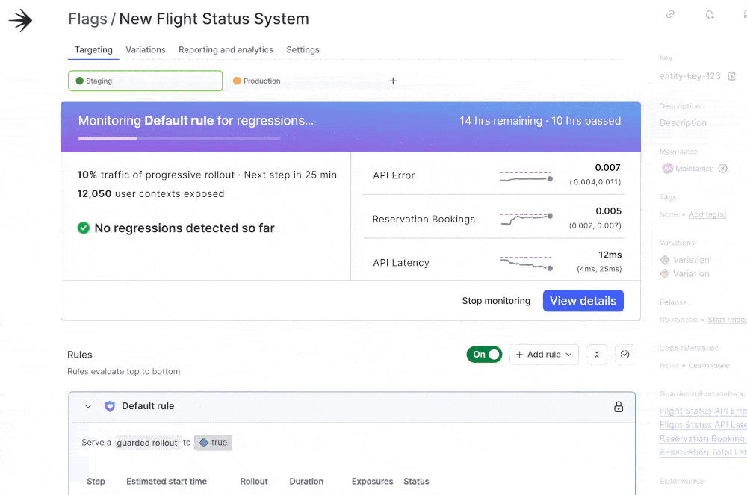
G U A R D E D R E L E A S E S
97% reduction in overnight and weekend releases and a 300% increase in production deployments.
Take the risk out of software releases
“Did we get ourselves out of nights and weekends? Largely, yes.”
Nathan Gray, Director of Digital Engineering Operations
Progressively rollout changes and use multi- dimensional targeting to minimize blast radius
Set and monitor performance thresholds like errors and latency in real-time
Detect application issues and instantly recover with auto-rollbacks
Link bugs to flags and correlate metrics for streamlined troubleshooting with error monitoring and session replay
Notes:
Guarded Releases: Releases are risky. Deploying features to all users at once creates massive risk, and it’s easy to miss early warning signs - because they're usually non-existent until it's too late. When things break, firefighting to fix them erodes customer trust with extensive downtime because figuring out what went wrong isn’t always straightforward. What if you could prevent outages before they happen? We've developed Guarded Releases to make every deployment safe and controlled, and here's why engineers say they’d never go back:
Releases should be targeted and rolled out gradually to minimize impact. That’s why we have Multi-dimensional Targeting & Progressive Rollouts to specify rollout audiences by attributes like location or OS, use Percentage-Based Rollouts to gradually release features to a subset of users, and make Dynamic Adjustments to modify rollout settings in real-time without redeploying.
Bugs need to be caught early, not by your customers. We help you Set and Monitor Performance Thresholds by connecting metrics via LaunchDarkly’s API/SDKs, Sentry, or OpenTelemetry, using Duration Monitoring to track metrics over flexible windows, and deploying Regression Detection to send real-time alerts for quick fixes.
We do the work for you with Automated Rollbacks to instantly roll back changes when thresholds are breached, minimize downtime, and reduce MTTR - helping teams avoid late-night emergencies. *A little unsure about automation? No worries. We’ll notify you on PagerDuty, Slack, and Email to tell you something has gone wrong.
And no more guessing - our Error Monitoring ties errors directly to feature flags for fast diagnosis, Breadcrumbs and Stack Traces provide user path insights, and Real-Time Notifications alert you to new issues immediately so you can act fast.

Slide 6



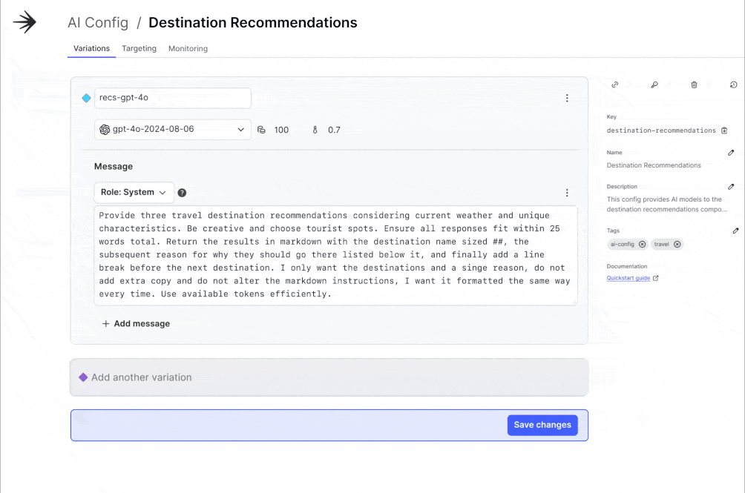
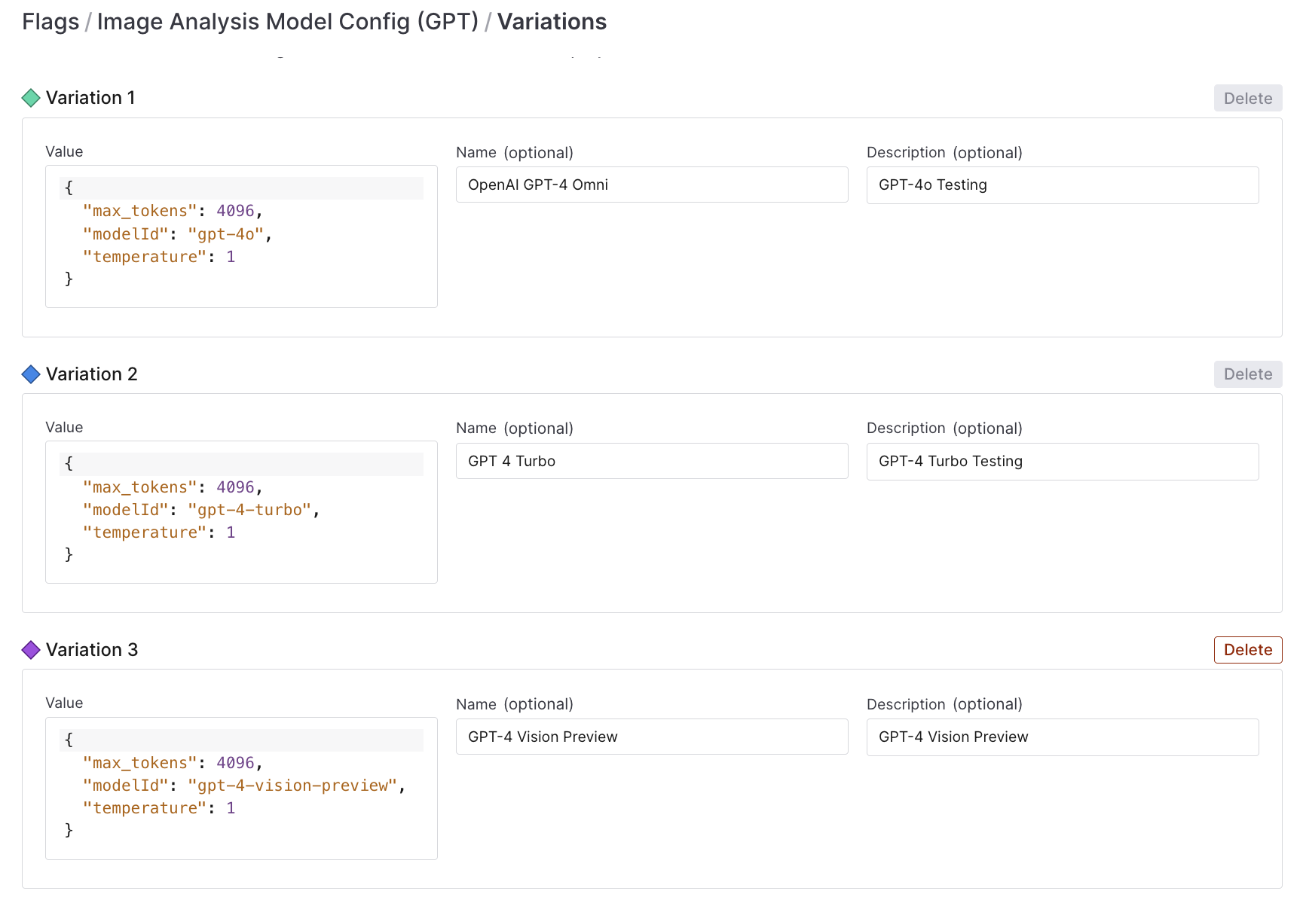
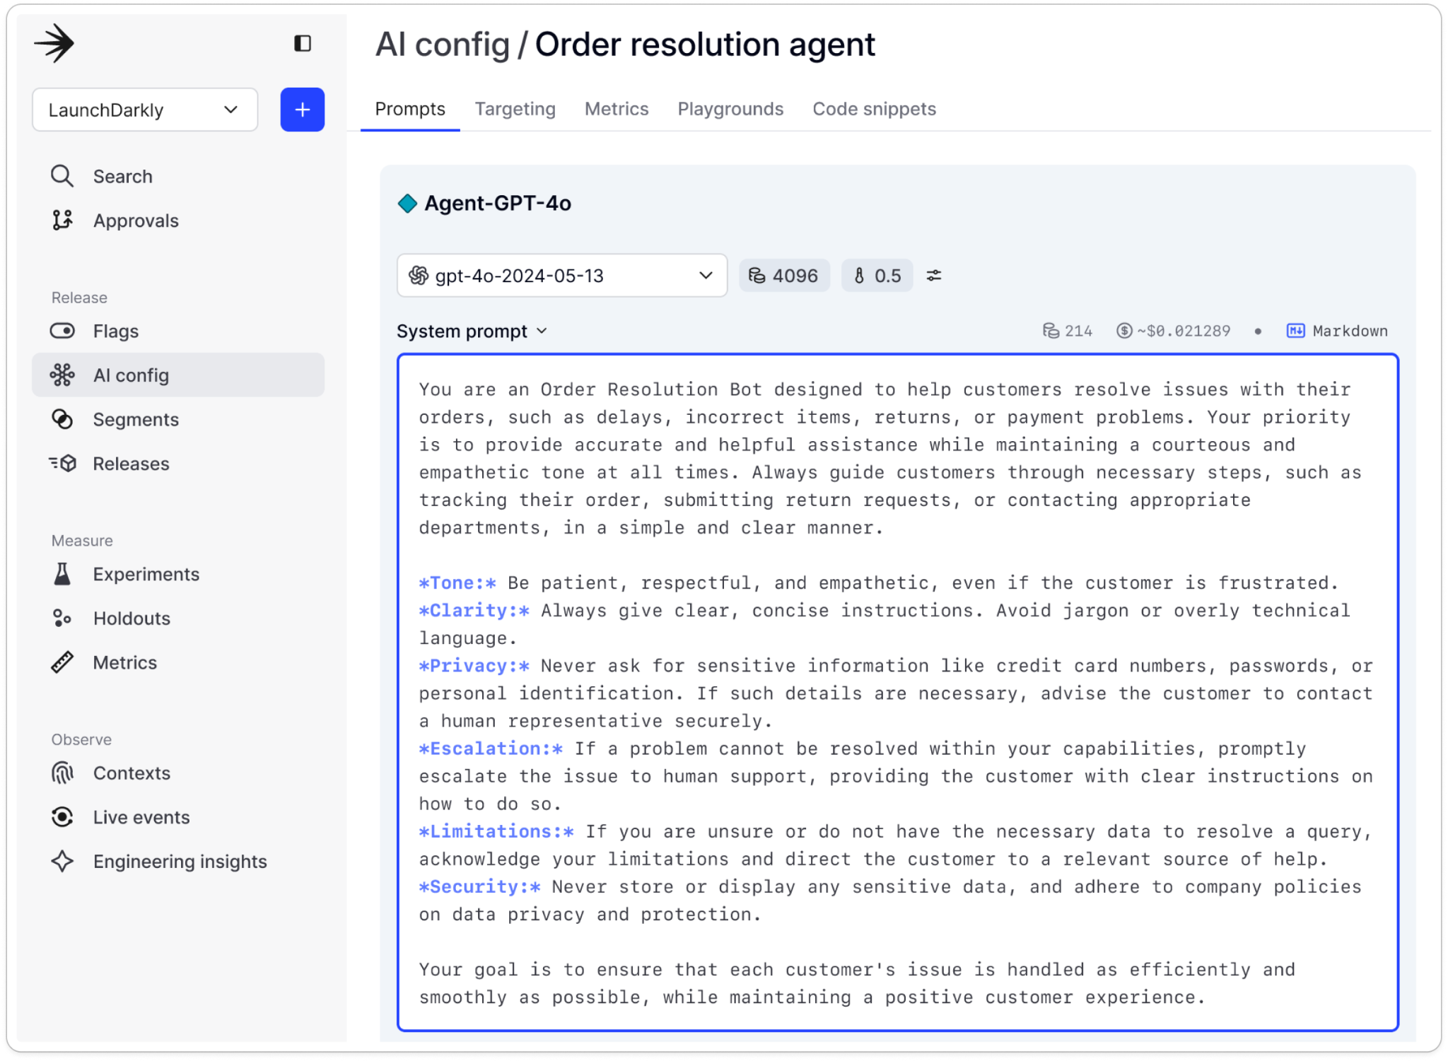
A I C O N F I G U R A T I O N S
“LaunchDarkly really helps us streamline and react really fast. So I think it’s providing us a scalable solution to test many models at the same time with relative ease, and then reduce the time to deploy."
Accelerate AI
Scott Gainous, Vice President of Engineering
Rapidly iterate on prompt and model configurations at runtime and rollback instantly
Monitor key AI metrics and fall back to a safe model configuration if performance degrades
Target specific audiences with new releases and customized experiences
Optimize performance and business impact by experimenting to find the right model and prompt combinations
Notes:
Accelerate AI: Building GenAI-based software is complex because you’re using non-deterministic models while trying to build consistent, high-quality experiences. That complexity is paired with pressure to bring great GenAI software to market quickly.
With AI configs, you get the only control plane to release, monitor, and optimize AI products at runtime, giving you the power to:
Iterate quickly on prompts and model configurations to build the ideal customer experience — at runtime, with no redeployment required.
Monitor key AI metrics and change to fallback models when issues occur to preserve your end user experience and reduce dependencies on 3rd-party providers.
Experiment to find the optimal model size, external data, configuration, and prompt for each use case to deliver great customer experiences at the right cost.
Target audience segments to ensure that each user has the right experience. Introduce beta programs and control costs by only using more expensive models for the appropriate audiences, and progressively roll out to safeguard releases.
When Hireology first started building GenAI features, the non-deterministic nature of AI posed unique challenges for quality assurance and deployment. Now they use LaunchDarkly as a key part of its AI development strategy to enable safe testing and deployment of features while maintaining high standards for quality, achieving several significant improvements:
Rapid deployment: The team now deploys multiple times per week, with the ability to quickly respond to any issues.
Improved ability to test AI models at scale: LaunchDarkly makes it easier to serve model variations within the team's testing framework. They can now automatically evaluate different models and configurations across various industry verticals, with each test examining specific quality criteria such as proper job title placement and location information.
Enhanced user control and feedback: Hireology implemented a public preview system that gives customers control over adopting new AI features.

Slide 7


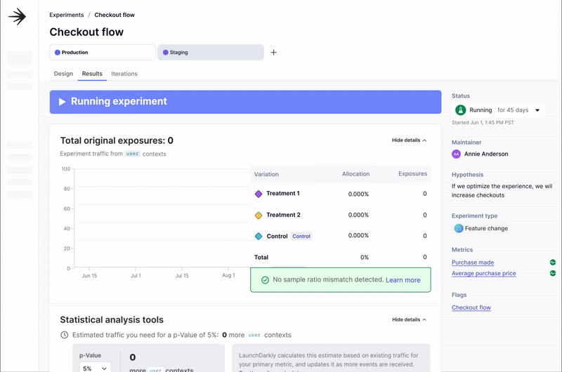
E X P E R I M E N T A T I O N
“The ability to target experiments and analyze results efficiently has been a game-changer for us. It’s enabled us to run more tests and gain actionable insights much faster."
Remove barriers to experimentation
Riley Duncan, Data Analyst
Enable engineering teams to seamlessly build and
attach experiments to any feature, model, or prompt
Empower all stakeholders to make informed
decisions with experiment results and analysis
Design experiments with a statistically rigorous
toolkit to ensure trustworthy, actionable results
Gain richer, more holistic insights with warehouse native experimentation and product analytics
Easily conduct real-time experiments with results your PM, Eng, Data teams trust
Enable personalization with advanced, granular targeting
Ship winning feature variations in real-time without code changes
Notes:
Experimentation is hard for engineering teams because experimentation workflows are disconnected from feature delivery, tools lack the flexibility and scalability to meet experiment requirements, and results are often siloed in separate tools or difficult to interpret. All this makes it hard to measure and understand feature impact, iterate on features effectively, and ship the most impactful variations.
That’s why it's critical to unify feature delivery and experimentation in one seamless workflow. When you do this, you unlock the power to:
Enable engineering teams to easily support experimentation demands by integrating experimentation into their feature delivery workflow and attaching experiments to any feature, model, or prompt.
Empower all stakeholders with centralized access to experiment results and analysis. Visualize results, quickly determine statistical significance, and ship the best-performing features.
Design experiments with a statistically rigorous toolkit so that your data teams trust the results. Choose between different statistical models (such as Bayesian or Frequentist), measure against custom metrics, and leverage advanced targeting to ensure your experiment meets your team’s goals.
Integrate experimentation with your data warehouse to reduce data fragmentation and gain more holistic analysis that leverages all available data.
Experimentation doesn’t need to be complex or painful. Before LaunchDarkly, Savage X Fenty struggled with disconnected workflows and rigid tools that hindered effective experimentation. By adopting LaunchDarkly’s unified approach to feature delivery and experimentation, they gained the flexibility to design experiments tailored to their needs, reduced the development resources required, and empowered their teams to run more tests. As a result, they were able to turn insights into action and consistently deliver better experiences for their customers.

Slide 8


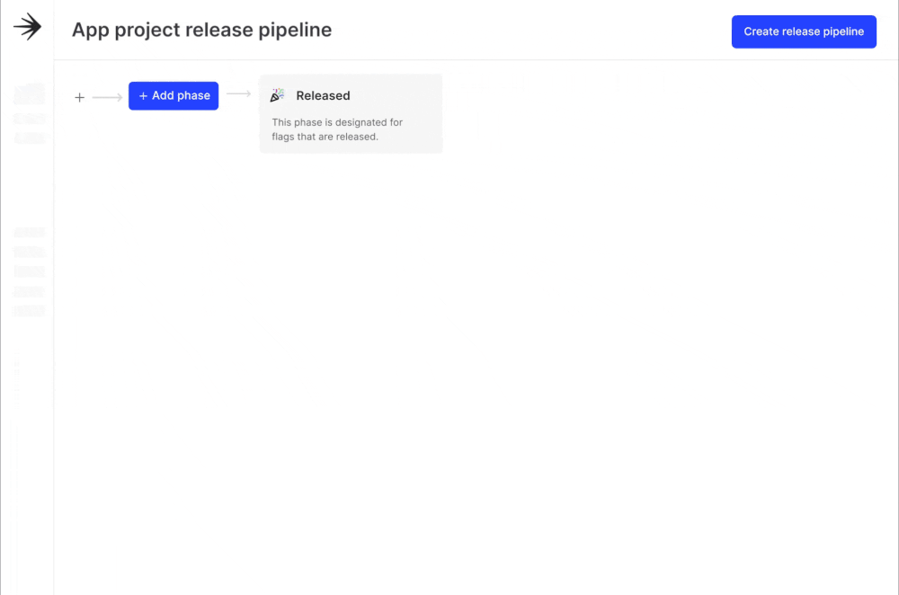
R E L E A S E M A N A G E M E N T
Increase developer
productivity
Went from releasing every 6-8 weeks to releasing every week
Automate and standardize release best practices
with repeatable release pipelines & workflows
Get automated flag cleanup recommendations and effectively manage the full flag lifecycle
Gain visibility into releases and best practice recommendations with release health insights
Scale and manage access across your entire organization with custom roles and approvals
Notes:
Most engineering teams have an idea of how they want to release in an ideal world, but scaling great release practices across an organization takes the right combination of tools and processes. Without an enterprise-scale feature management platform, ensuring safe, standardized, scalable releases across teams is nearly impossible, leading to process breakdowns, errors, and inefficiency. With LaunchDarkly, you can control how your entire organization approaches releases, with the power to:
Create standardized pipelines for scalable, automated rollouts aligned to organizational best practices and governance standards.
Manage your flag lifecycle and avoid tech debt with automated recommendations for flag cleanup. Users can also filter flags by lifecycle status for easy organization.
Get release health insights from the Launch Insights dashboard, a project-level view that gives engineering leaders a better understanding of how their teams are running feature management and experimentation and what they need to do to follow best practices.
Use custom roles and approvals to give everyone on your team the right amount of access to collaborate on release management.
Before using LaunchDarkly, Paramount didn’t separate deployment from release and used to deploy/release once or twice a month. Multiple teams in their Content Engineering org now use LaunchDarkly feature flags to deploy 14 applications on-demand at a pace of around 6-7 times a day, a 100x improvement in deployment velocity.

Slide 9
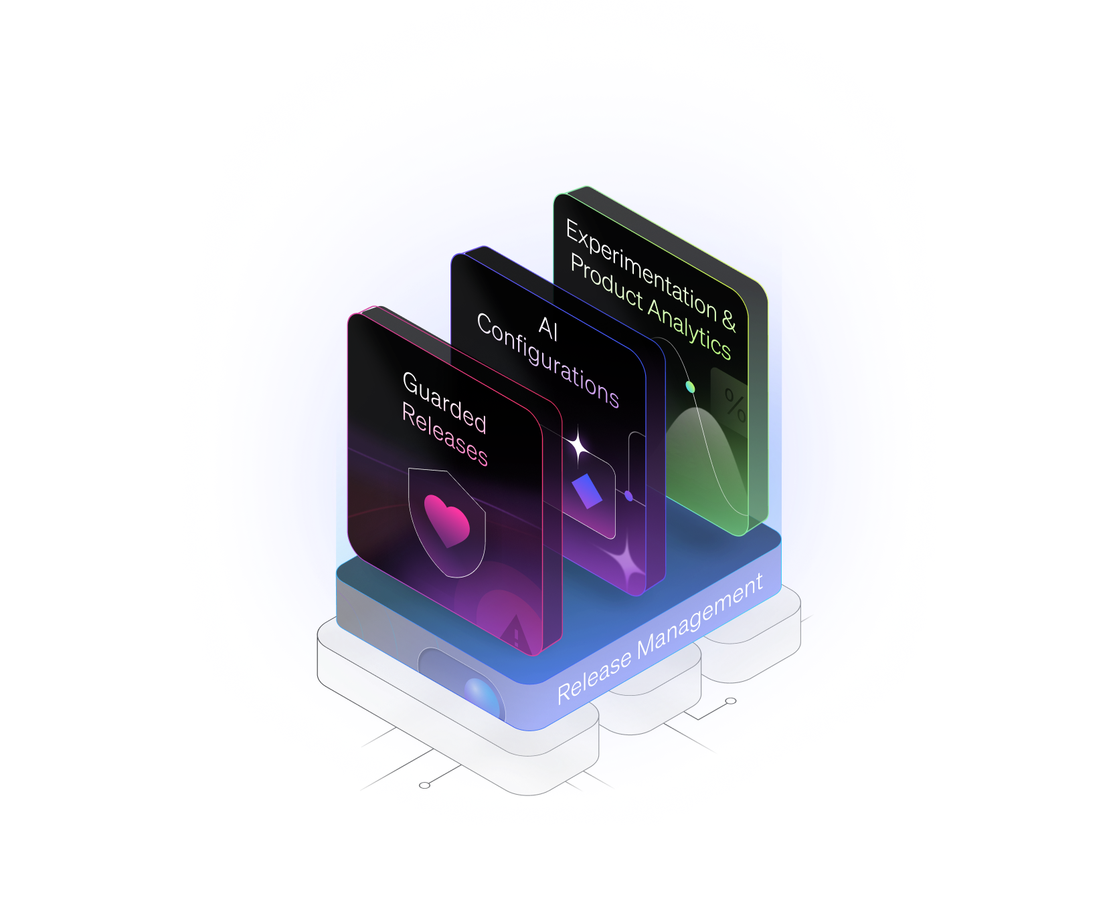















The LaunchDarkly Platform
Experimentation & Product Analytics
Guarded Releases
Targeting & progressive rollouts
Attach experiments to any feature, model, or prompt
Set and monitor performance thresholds
Experiment results and analysis
Automated rollbacks
Statistically rigorous toolkit
Error monitoring & session replay
Warehouse native experimentation & product analytics
AI Configurations
Release Management
Manage prompt and model configurations at runtime
Standardized release pipelines
Monitor key AI metrics with model fallbacks
Flag cleanup recommendations
Target GenAI experiences
Release health insights
Experiment with models and prompts
Custom roles and approvals
Enterprise-Scale Performance
100+ Global Points of Presence
Governance & Security
Secure Application Connectivity
Audit Logs
Feature Dependency Control
Developer-Enabled Workflows
25+ Languages & Frameworks
Developer-First Integrations
API First
Multi-Region Resilience
35 Trillion Flags Delivered Daily
Notes:
LaunchDarkly is a feature management platform that helps software teams reduce the risk of deploying bad software or AI applications while accelerating release velocity. Here’s how we deliver value:
Guarded Releases Progressively roll out features, monitor critical metrics in real-time, and roll back instantly if needed. Simplify issue resolution with error monitoring, taking the risk out of every release. This means your team can deliver updates with confidence, protecting the user experience and avoiding costly downtime.
AI Configurations Iterate quickly on prompts and model configurations to build ideal customer experiences without redeploying. Test and optimize configurations for specific audiences while safeguarding the user experience with kill switches and model fallbacks. This accelerates AI innovation while minimizing the risk of errors and disruptions for your end users.
Experimentation Unify feature delivery and experimentation in one workflow. Use our advanced stats engine and warehouse-native capabilities to measure feature impact across all platforms. By gaining data-driven insights, your teams can continuously improve product performance and drive better business outcomes.
Release Management Implement standardized release pipelines, automated flag clean-up, and team-specific release insights to ensure consistency and efficiency across teams. This streamlines processes, reduces technical debt, and empowers teams to deliver higher-quality releases faster.
Our platform is built on an enterprise-grade foundation, handling over 35 million flag evaluations daily, supporting 26 language SDKs, and providing robust security with RBAC, audit logs, and encryption.

Slide 10
Delivering outcomes for our customers
De-Risk Every Release
Reduce the blast radius of errors to <1% of users
Accelerate AI Development
Reduce the time spent on managing AI configs by 20-30%
Remove barriers
to experimentation
5x the number of experiments your team runs
Increase Developer Productivity
Release code 84% more
frequently vs. non-customers
2024 Customer Survey |
Gartner
Notes:
LaunchDarkly drives measurable impact for your team. With our platform, you can reduce the blast radius of errors to less than 1%, ensuring safer releases with minimal disruption. For AI teams, we cut time spent managing configurations by 20-30%, freeing you to focus on innovation. We also remove barriers to experimentation, enabling teams to run 5x more experiments and make faster, data-driven decisions.
LaunchDarkly boosts developer productivity, helping teams operationalize release best practices and release code 84% more frequently than non-customers. This means faster deployments, greater agility, and more value delivered to your customers. With LaunchDarkly, you can innovate quickly, release safely, and empower your teams to work efficiently and move with speed.

Slide 11















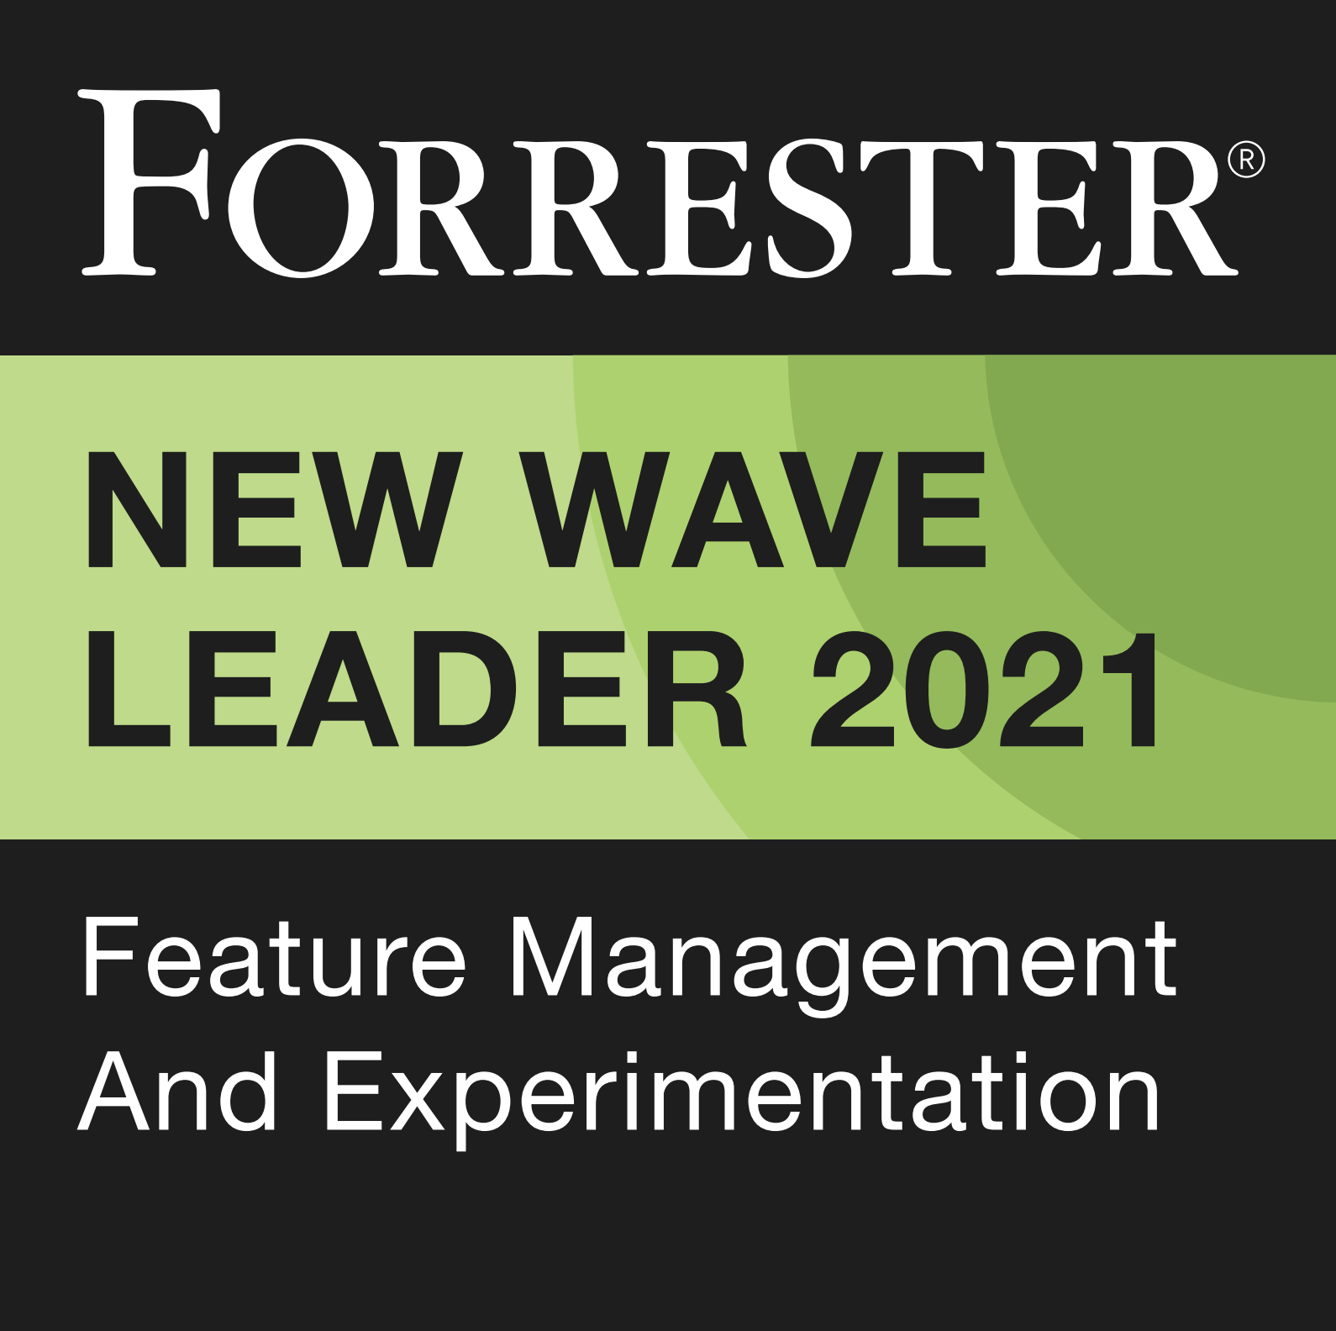
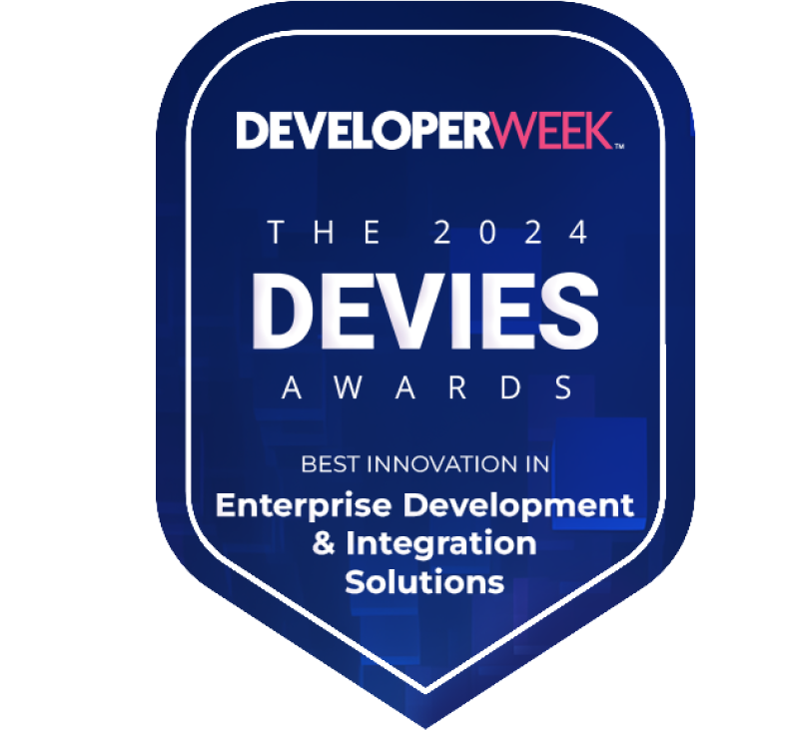






Trusted by the best software teams
Loved by developers
Trusted by the best
Enterprise-grade
LaunchDarkly revolutionized how we release software and our beta release processes. Game changer.
S E R V I N G
S C A L E
35T+ flags evaluated daily
Supports 26 Language SDKs
S E C U R I T Y
RBAC, Audit Logs, Encryption
Compliance with SOC2, GDPR, ISO 27001
R E A L - T I M E R E L I A B I L I T Y
200ms rollback
Multi-region resilience
SLAs and 24/7 Support
I N T E G R A T I O N S
CI/CD
Monitoring
Analytics
25%
of the Fortune 500
LaunchDarkly is the #1 Feature Management platform in the latest G2 Report
2023
CONFIDENTIAL
Notes:
Why Work With Us
At LaunchDarkly, we’re trusted by some of the best and most innovative teams around the world. We serve over 5,500 customers, including 25% of the Fortune 500. Some of the biggest brands like Santander, SAP, IBM, and Autodesk rely on LaunchDarkly to power their releases.
We’re proud to be the #1 Feature Management platform in the latest G2 report, and recently won a 2025 Devies award for best innovation in enterprise development and integration solutions.
What sets us apart is the scale, security, and reliability of our Enterprise-grade platform. Over 35 million flags are evaluated on our platform daily, we support 26 language SDKs and offer robust security features like RBAC, audit logs, and encryption. We also ensure real-time reliability with 200ms rollback times and multi-region resilience, so you can manage your releases at scale.

Slide 12
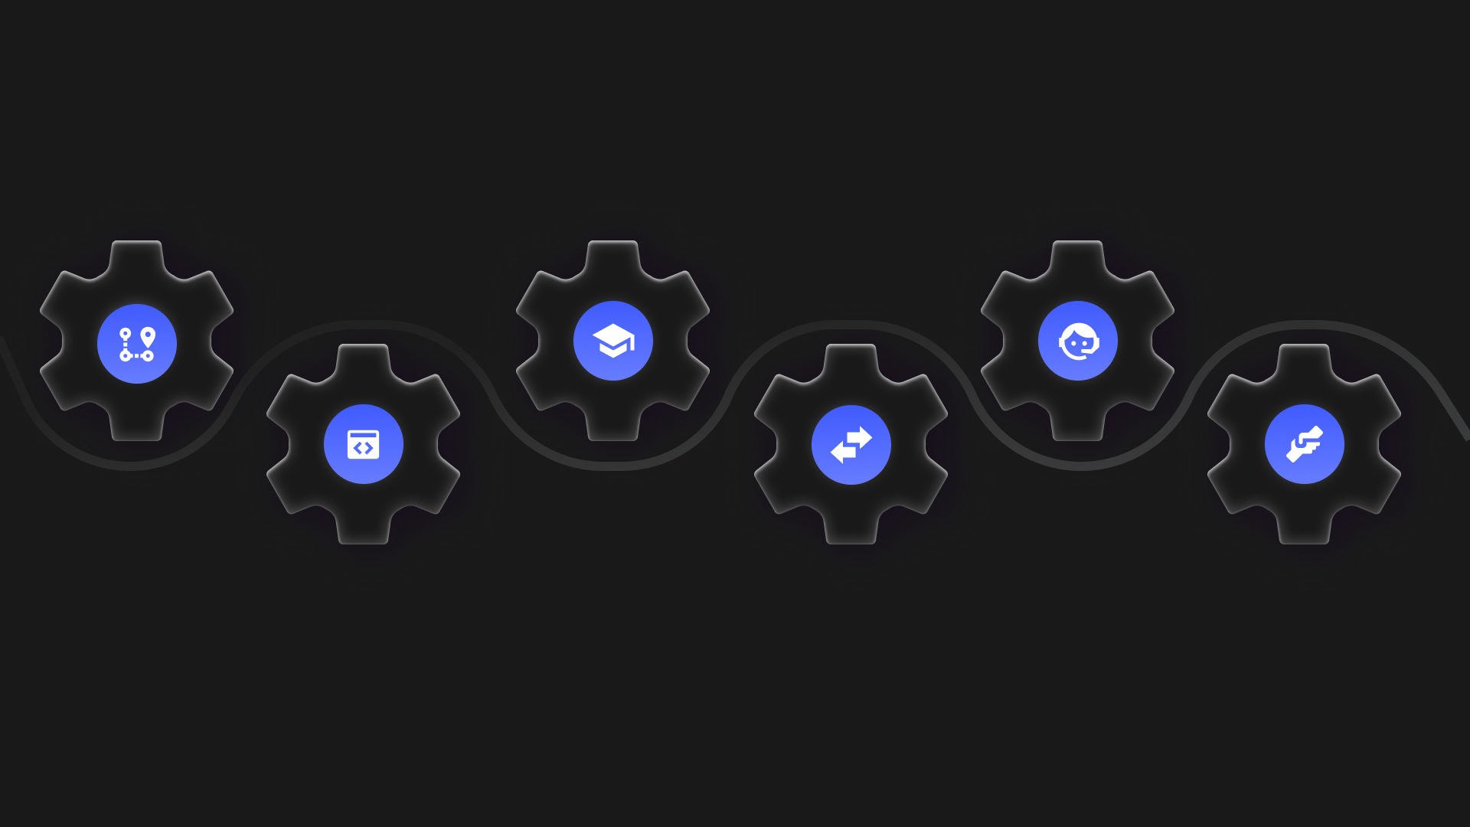
Helping you succeed every step of the way
Release Excellence Quickstart
Academy + Certification
24/7 Support
Hands-on consulting to get to great releases in days
Help your users become experts in a snap
Speak to an expert as you get started and as you grow
Custom-Tailored Advisory Sessions
Migration Tool
Resident Architect
Migrate your homegrown flags to an enterprise-wide platform
Embedded SMEs to accelerate and scale best practices adoption across your enterprise
Just-in-time training to guide your team through building your first flag, fully guarding releases and every step in between
Notes:
LaunchDarkly is committed to driving your success at every stage of your Release Excellence Journey, starting with our Release Excellence Quickstart, where hands-on consulting gets your teams delivering great releases in just days. If you’re migrating from homegrown or proprietary flags, our Migration Tool simplifies the process, easily consolidating everything into a single enterprise-grade platform.
To empower your teams, the LaunchDarkly Academy and Certification quickly turns users into platform experts and can be paired with our Custom-Tailored Advisory Sessions to provide just-in-time expert guidance, no matter where you are in your journey.
As you scale and grow, our Resident Solutions Architects can embed directly within your team, providing deep SDLC expertise to scale great releases seamlessly across the enterprise.
And to ensure you’re never alone, our 24/7 Support team is always ready to help solve issues in real-time.
With LaunchDarkly, we’re here throughout to make every release an exceptional one.

